Slide 1
Co-Extracting Opinion Targets and Opinion Words from Online Reviews Based on the Word Alignment Model

Slide 2
Abstract
Mining opinion targets and opinion words from online reviews are important tasks for fine-grained opinion mining, the key component of which involves detecting opinion relations among words.
To this end, this paper proposes a novel approach based on the partially-supervised alignment model, which regards identifying opinion relations as an alignment process. Then, a graph-based co-ranking algorithm is exploited to estimate the confidence of each candidate. Finally, candidates with higher confidence are extracted as opinion targets or opinion words.

Slide 3
EXISTING SYSTEM
The intuition represented by this strategy was that in sentences, opinion words usually co-occur with opinion targets, and there are strong modification relations and associations among them (which in this paper are called opinion relations or opinion associations).
Therefore, many methods jointly extracted opinion targets and opinion words in a bootstrapping manner . For example, “colorful” and “big” are usually used to modify “screen” in the cell-phone domain, and there are remarkable opinion relations among them.

Slide 4
DISADVANTAGES
Detect the opinion relations among words is a considerable challenge in this task.
Bootstrapping framework, which has the problem of error propagation.
An iteration, they would not be filtered out in subsequent iterations

Slide 5
PROPOSED SYSTEM
we propose a method based on a monolingual word alignment model (WAM). An opinion target can find its corresponding modifier through word alignment . “colorful” and “big” are aligned with the target word “screen”.
Compared to previous nearest-neighbor rules, the WAM does not constrain identifying modified relations to a limited window; therefore, it can capture more complex relations, such as long-span modified relations.

Slide 6
ADVANTAGES
1. Candidates with higher confidence than a threshold are extracted.
2. Opinion targets were extracted in a standard random walk framework.
3. Frequency statistics and phrase detection, to detect the proper opinion targets/words.

Slide 7
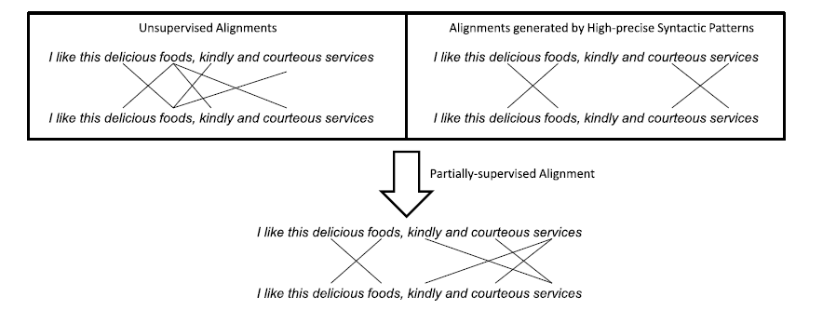
ARCHITECTURE

Slide 8
SYSTEM ANALYSIS
What is SDLC?
A software development process, also known as a software development life cycle (SDLC), is a structure imposed on the development of a software product.
Types of SDLC:
1. Water fall
2. Iterative model
3. Spiral model
4. Agile model
5. Prototype model
6. V model

Slide 9
SPIRAL MODEL
Adaptive (e.g. spiral) - Good when requirements and needs are uncertain. High technical risk.
In a failure - In a predictive LC it will be expensive because we get to know the failure after finishing everything but in adaptive LC only an iteration is wasted
This is an adaptive SDLC that cycles over and over again through development activities until project is complete. Here we go through some major steps.
1. Plan
2. Analyze and Design
3. Construct prototype
4. Test and integrate
These steps iterate till completion of the project. This is also can be viewed as a divide and conquer approach. In first few iterations complex or risky parts of the system are handled.

Slide 10
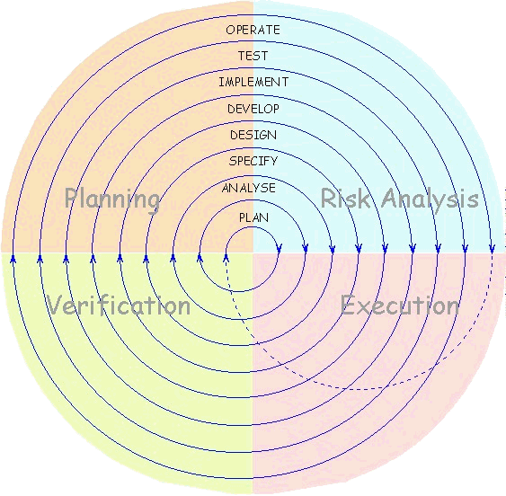
SPIRAL MODEL

Slide 11
UNIFIED MODELING LANGUAGE
Use Case Diagram
Sequence Diagram
Collaboration Diagram
State Chat Diagram
Activity Diagram
Component Diagram
Deployment Diagram
Class Diagram
ER Diagram
DFD

Slide 12
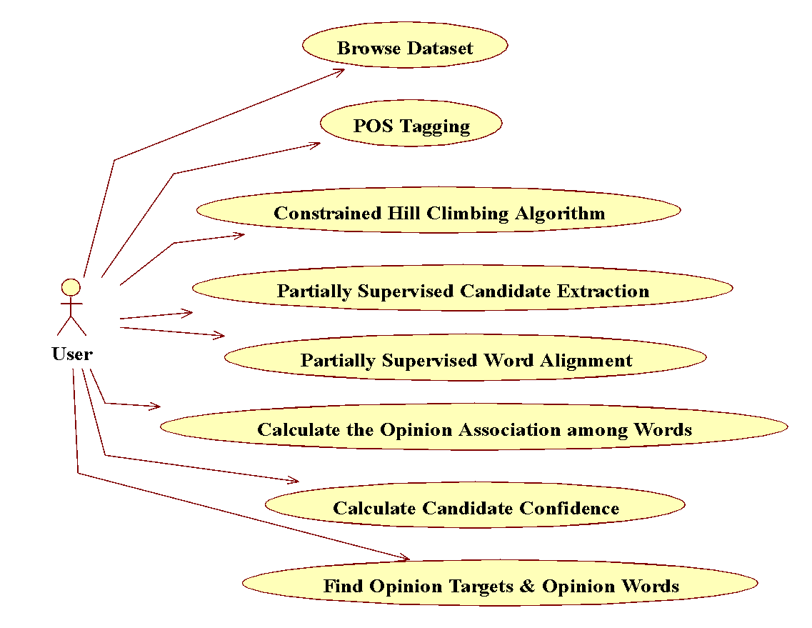
USE CASE DIAGRAM

Slide 13
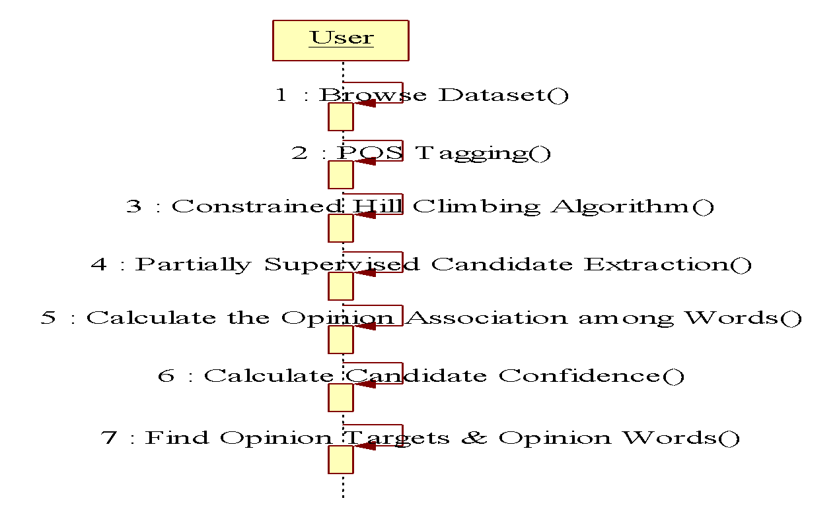
SEQUENCE DIAGRAM

Slide 14
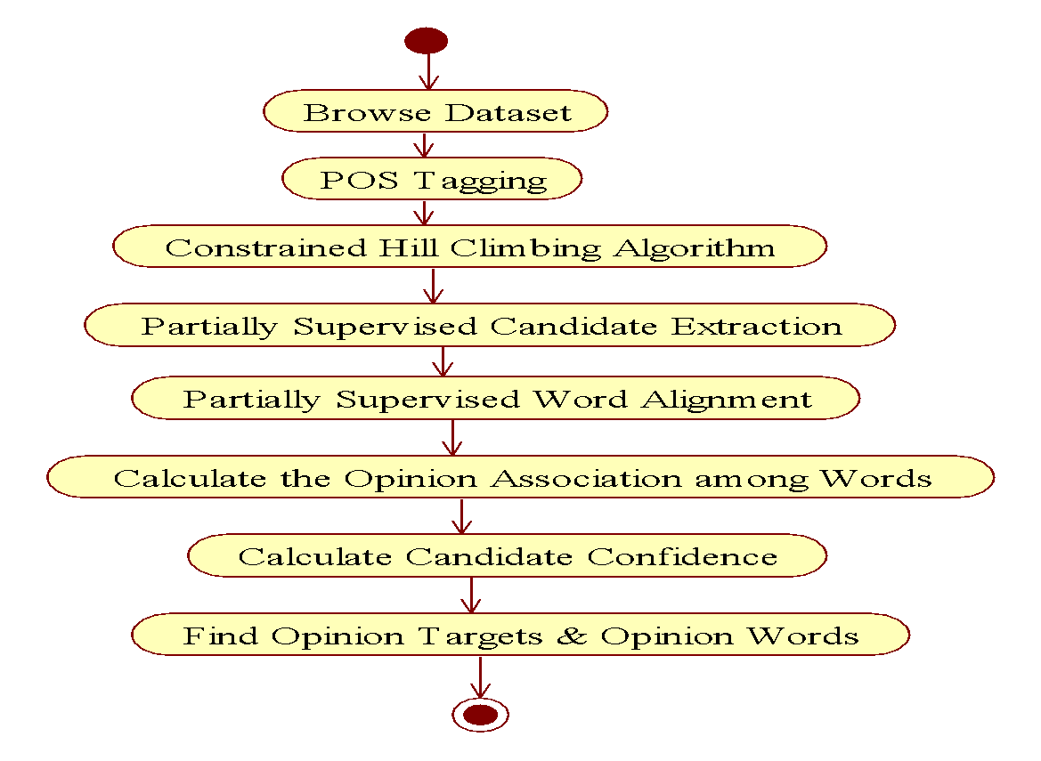
ACTIVITY DIAGRAM

Slide 15
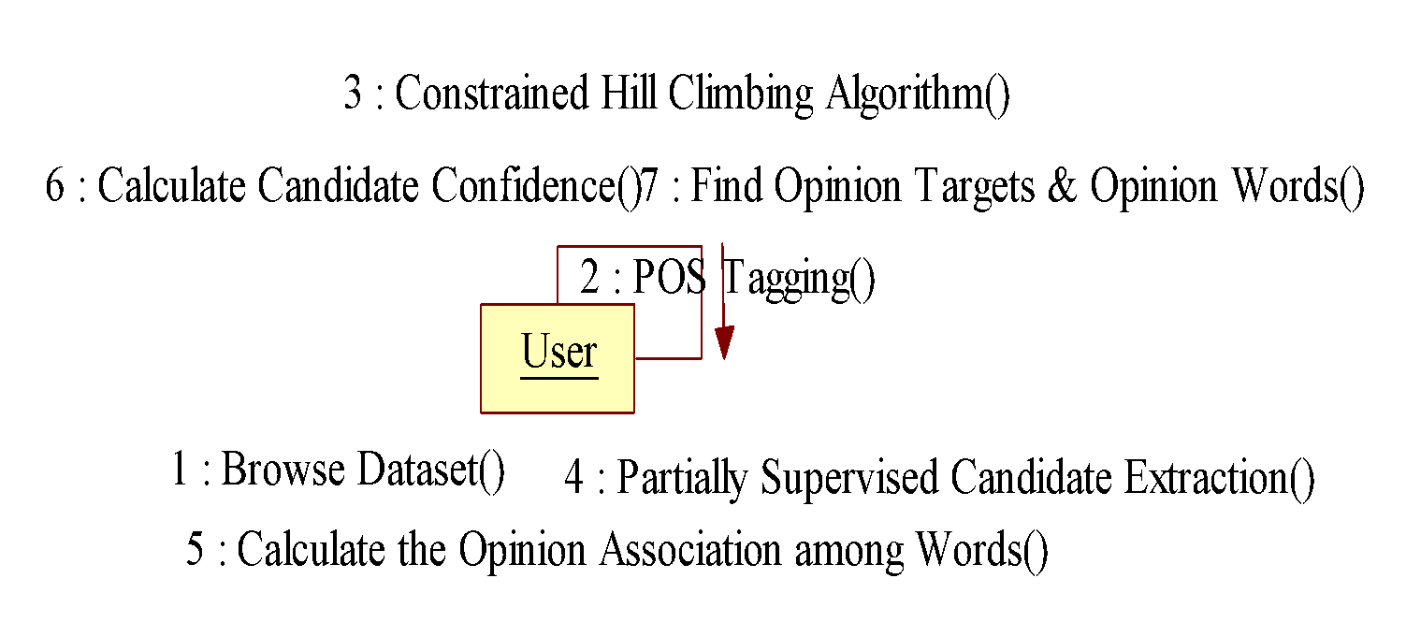
COLLABORATION DIAGRAM

Slide 16
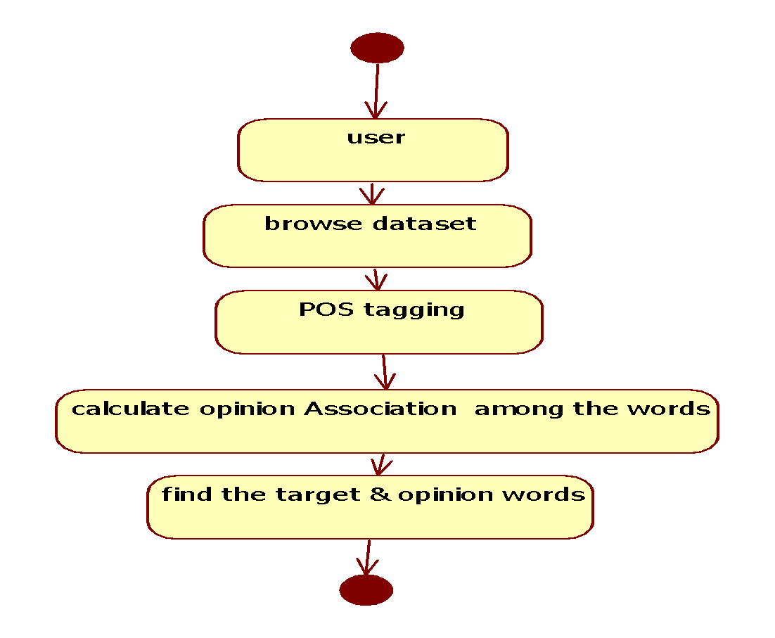
STATE CHART DIAGRAM

Slide 17
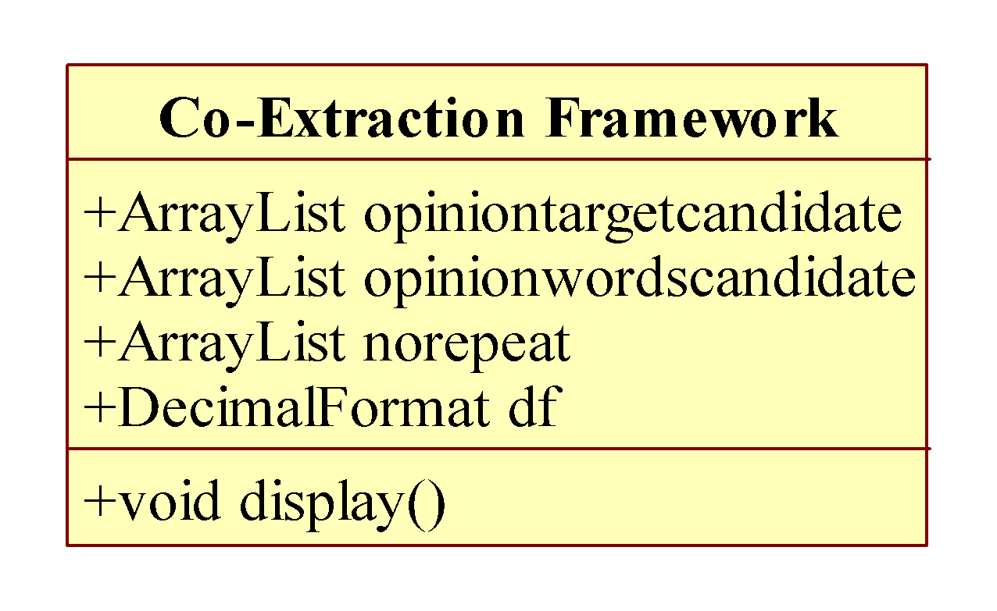
Class Diagram

Slide 18
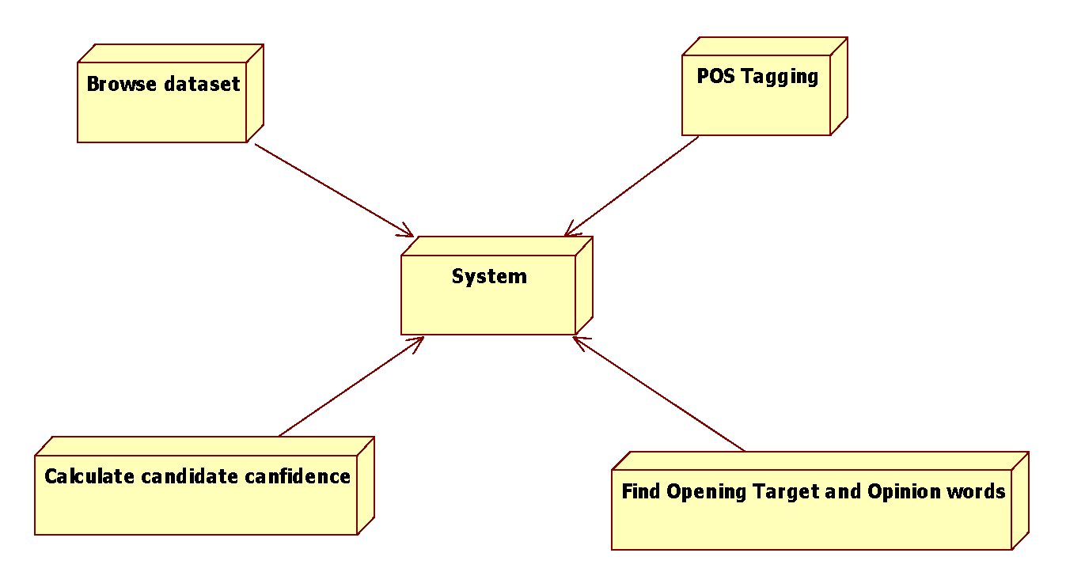
Deployment Diagram

Slide 19
DATA FLOW DIAGRAM
1. Dataflow: Data move in a specific direction from an origin to a destination.
2. Process: People, procedures, or devices that use or produce (Transform) Data. The physical component is not identified.
3. Source: External sources or destination of data, which may be People, programs, organizations or other entities.
4. Data Store: Here data are stored or referenced by a process in the System.
5. Ramous:

Slide 20
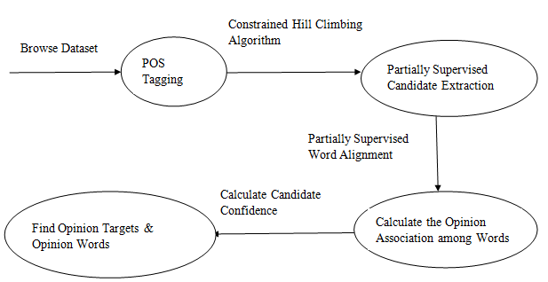
DATA FLOW DIAGRAM

Slide 21
Software Requirements Specification
Operating System : Windows 7/Windows 8
IDE : Net Beans 8.0/7.3/6.8
Software setup : Jdk8/JDK 7/JDK 6
Technology : Java Standard Edition
Note : As per Operating system setting need to Install JDK (32bit/64 bit)

Slide 22
Hardware Requirements:
Processor : Any Processor above 500 MHz
RAM : 2 GB
Hard Disk : 10 GB
Compact Disk : 650 Mb
Input device : Standard Keyboard and Mouse

Slide 23
MODULES DESCRIPTION
SYSTEM MODEL
Partially supervised alignment model
POS Tagging & Hill climbing
Partially Supervised candidate Extraction & word alignment
Calculate candidate confidence

Slide 24
Partially supervised alignment model
partially-supervised word alignment model (PSWAM). At first, we apply PSWAM in a monolingual scenario to mine opinion relations in sentences and estimate the associations between words.
Then, a graph-based algorithm is exploited to estimate the confidence of each candidate, and the candidates with higher confidence will be extracted as the opinion targets. Compared with existing syntax-based methods,

Slide 25
POS Tagging & Hill climbing
The standard word alignment model is usually trained in a completely unsupervised manner, which may not obtain precise alignment results.
Thus, to improve alignment performance, we perform a partial supervision on the statistic model and employ a partially- supervised alignment model to incorporate partial alignment links into the alignment process.

Slide 26
Partially Supervised candidate Extraction & word alignment :
These methods usually adopted coarser techniques, such as frequency statistics and phrase detection, to detect the proper opinion targets/words.
They put more emphasis on how to cluster these words into their corresponding topics (or) aspects. we obtain a set of word pairs, each of which is composed of a noun/noun phrase (opinion target candidate) and its corresponding modified word (opinion word candidate).

Slide 27
Calculate candidate confidence
we propose a graph-based co-ranking algorithm to estimate the confidence of each candidate. calculate the prior knowledge of candidates for indicating some noises and incorporating them into our ranking algorithm to make collaborated operations on candidate confidence estimations.
Finally, candidates with higher confidence than a threshold are extracted. Compared to the previous methods based on the bootstrapping strategy, opinion targets/words are no longer extracted step by step. Instead, the confidence of each candidate is estimated in a global process with graph co-ranking. Intuitively, the error propagation is effectively alleviated.

Slide 28
REFERENCES
[1] M. Hu and B. Liu, “Mining and summarizing customer reviews,” in Proc. 10th ACM SIGKDD Int. Conf. Knowl. Discovery Data Mining, Seattle, WA, USA, 2004, pp. 168– 177.
[2] F. Li, S. J. Pan, O. Jin, Q. Yang, and X. Zhu, “Cross- domain coextraction of sentiment and topic lexicons,” in Proc. 50th Annu. Meeting Assoc. Comput. Linguistics, Jeju, Korea, 2012, pp. 410–419.
[3] L. Zhang, B. Liu, S. H. Lim, and E. O’Brien-Strain, “Extracting and ranking product features in opinion documents,” in Proc. 23th Int. Conf. Comput. Linguistics, Beijing, China, 2010, pp. 1462–1470.

Slide 29
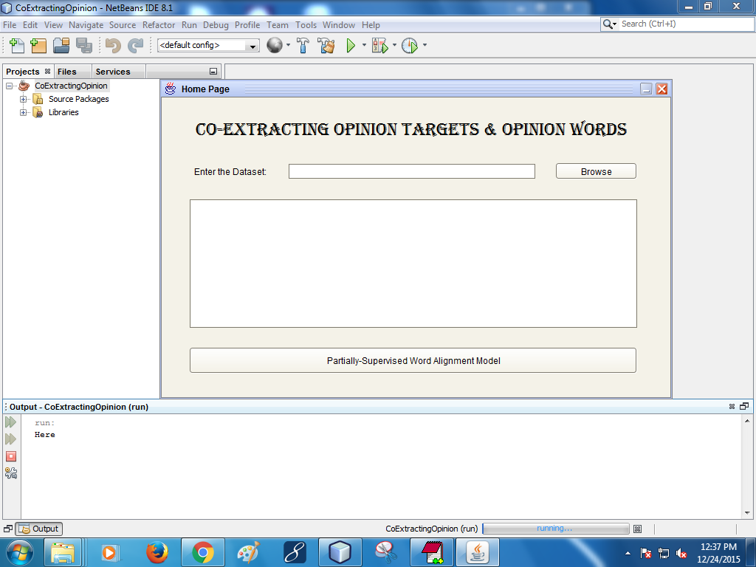
Screen short

Slide 30
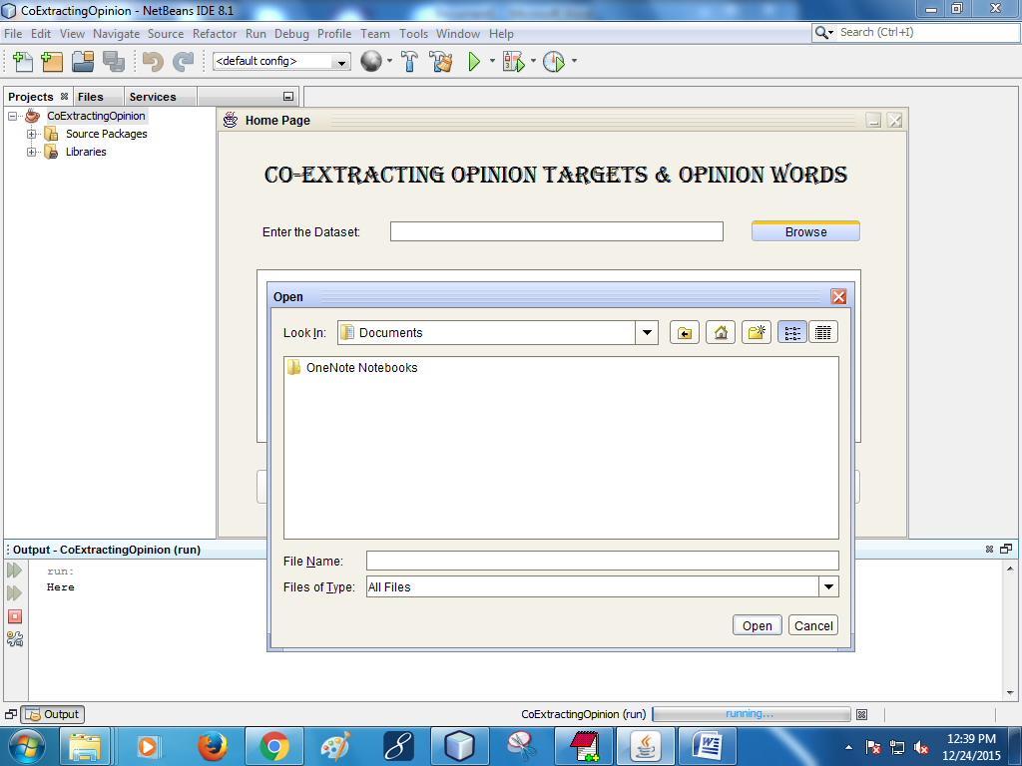

Slide 31
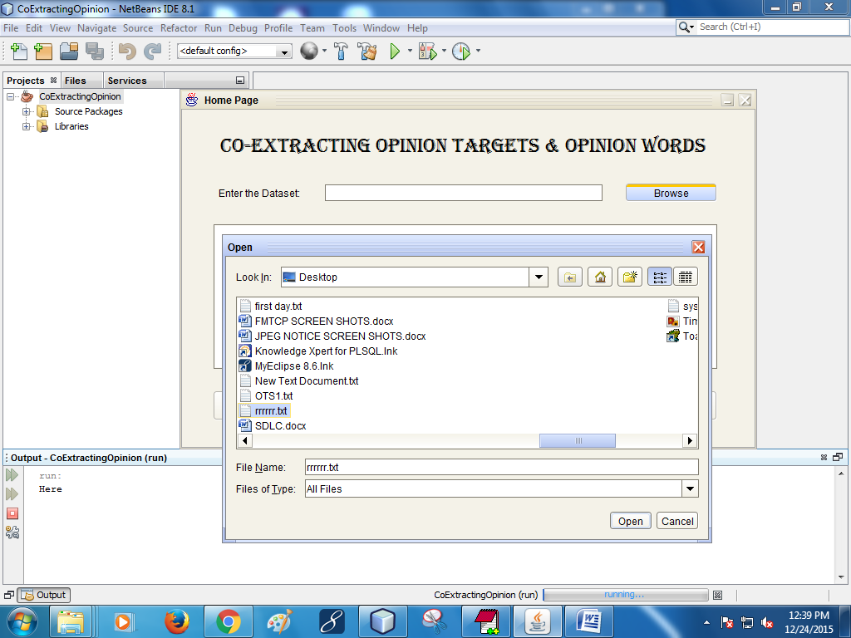

Slide 32
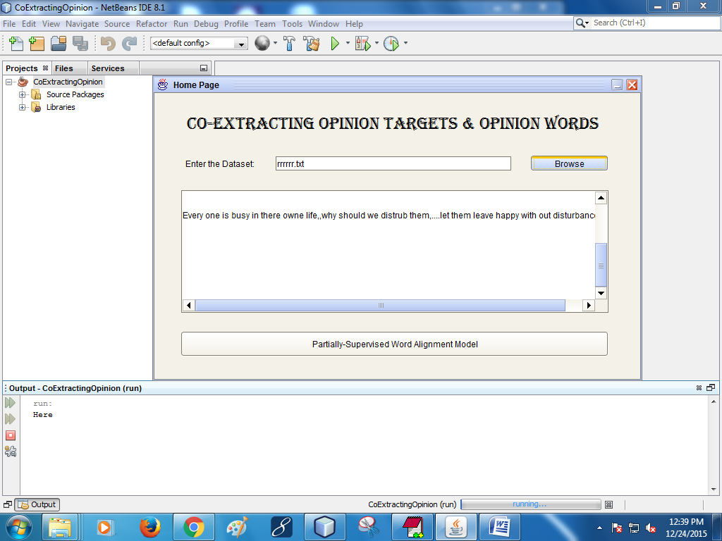

Slide 34
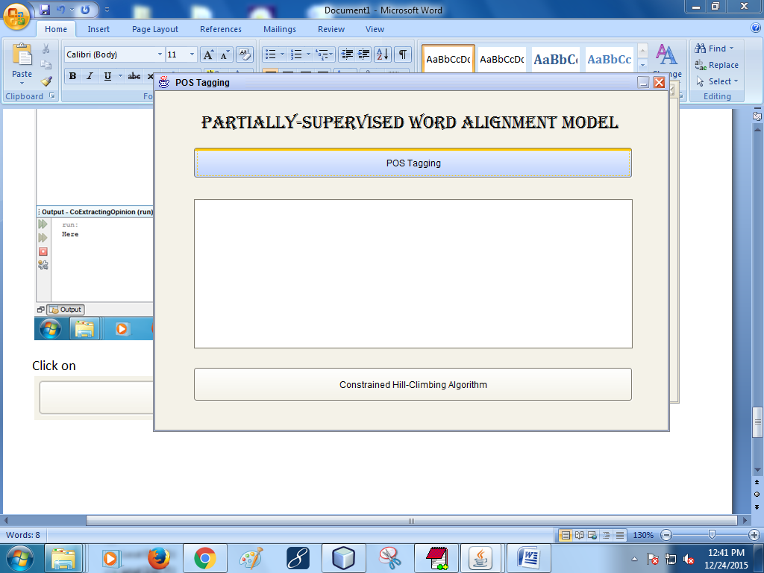

Slide 35
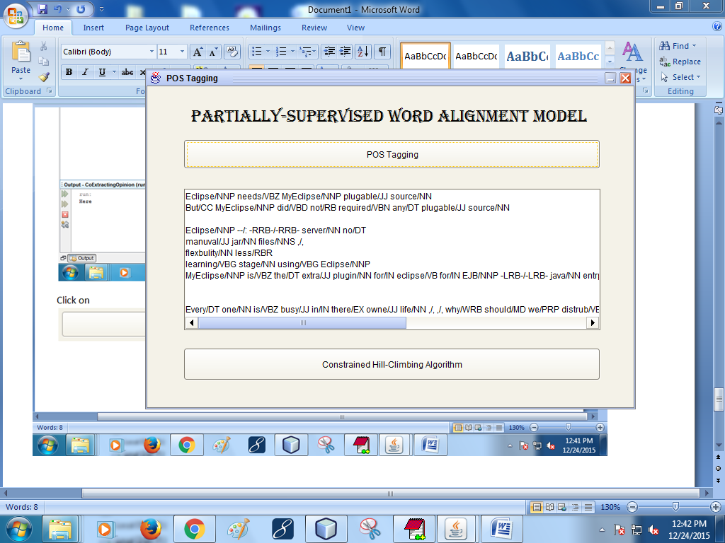


Slide 36
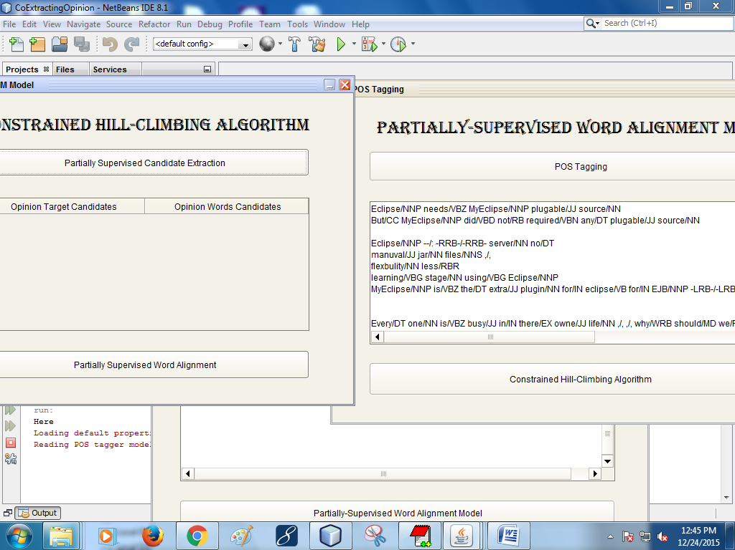



Slide 37
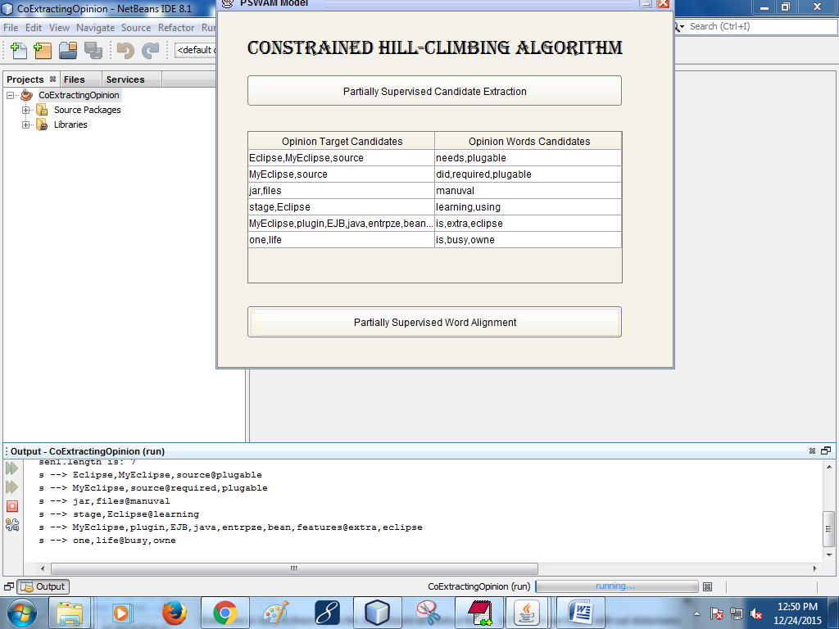

Slide 38
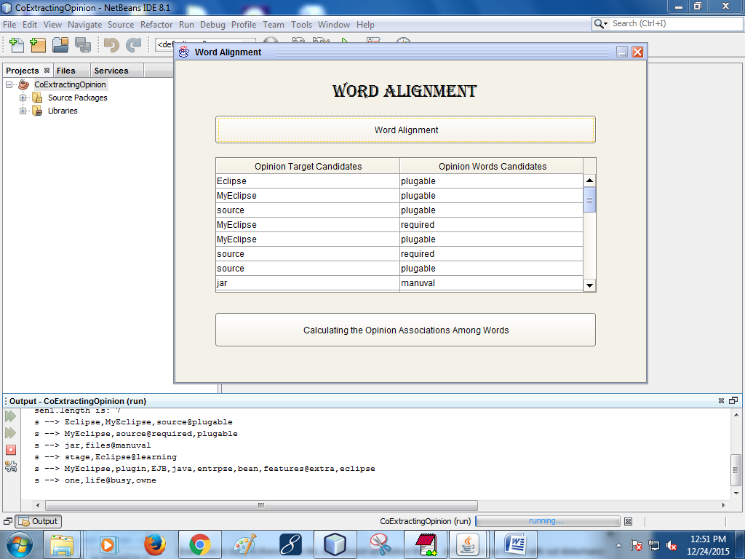

Slide 39
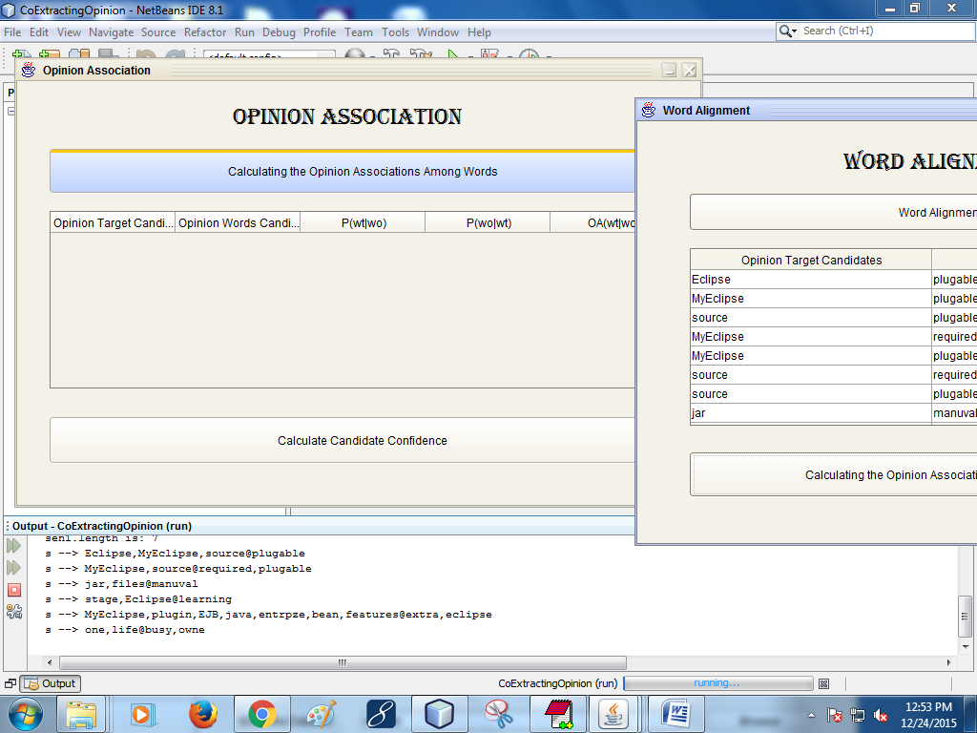


Slide 40
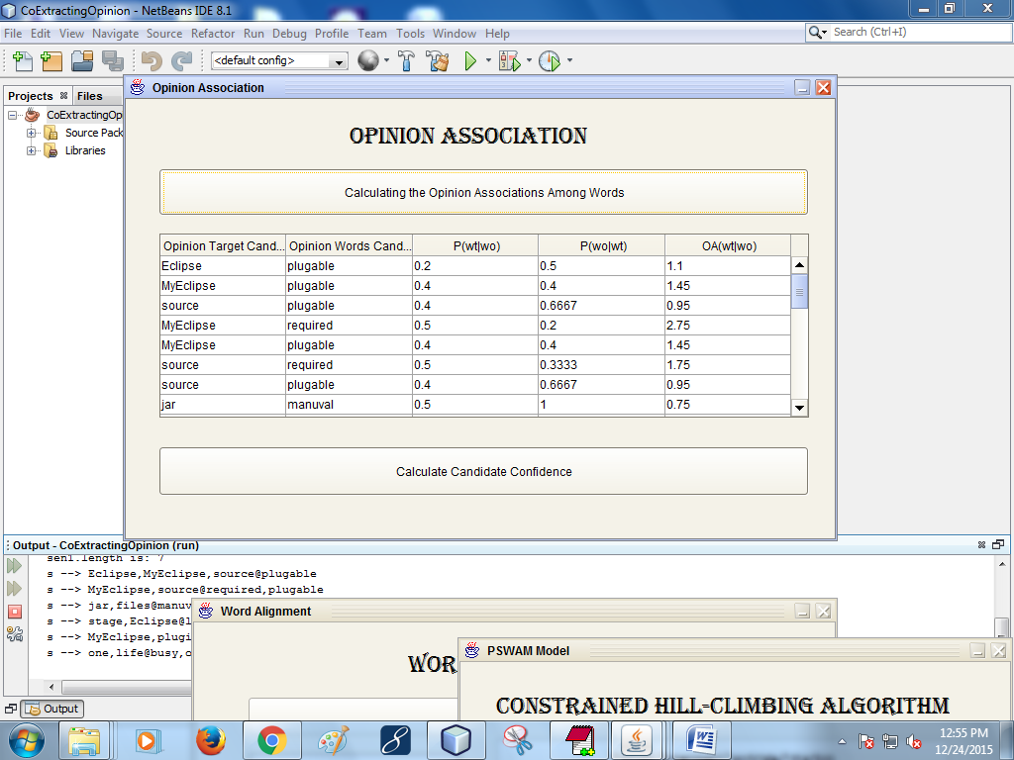


Slide 41
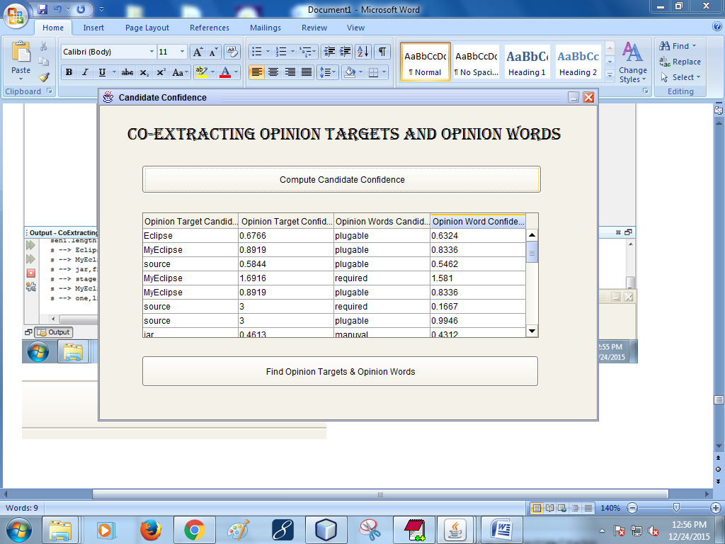


Slide 42
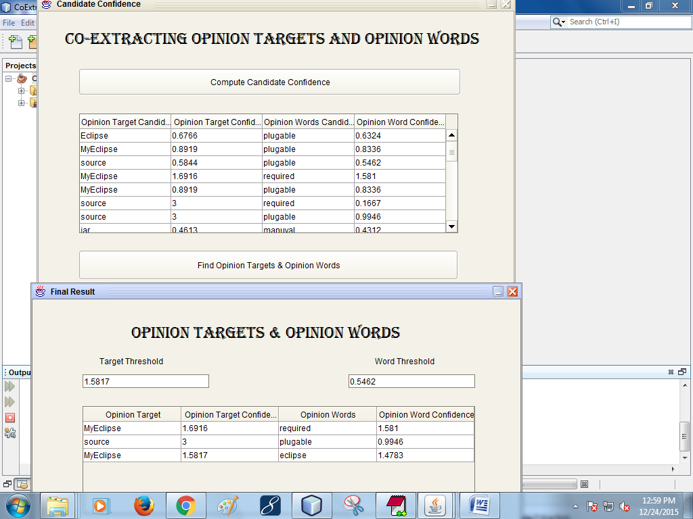


Slide 43
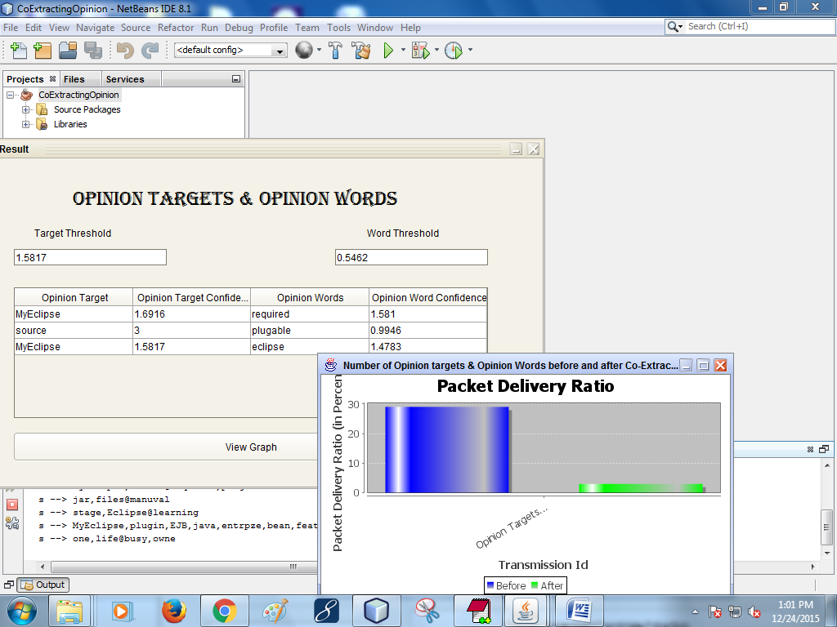

Slide 44
ANY QUERIES

Slide 45
THANK U

